Slide 1
GRB 201015A: from seconds to months optical monitoring and supernova discovery
Belkin S.O. (HSE University, IKI RAS),
Pozanenko A.S. (IKI RAS), Minaev P.Yu. (IKI RAS), Volnova A.A. (IKI RAS), Pankov N.S. (HSE University, IKI RAS)

Slide 2
Introduction
$$E\sim {10}^{52−54} erg$$
$$0,01 с.≤t≤1000 s.$$

Slide 3
Gamma-ray bursts classification
Short GRBs | Long GRBs
Duration less than ~ two seconds | Duration more than ~ two seconds
NS+NS or NS+BH merging | Core-collapse supernova (Ib/c)

Slide 4
Schematic light curve of gamma-ray bursts in the optical range
Active phase
Afterglow
Supernova
Supernova
Jet-break
Host galaxy
Host galaxy

Slide 5
GRB 201015A: review
Registration date : October 15, 2020, 22:50:13 UT;
Registration: BAT/Swift (GCN Circ. 28632), XRT/Swift (GCN Circ. 28635), UVOT/Swift (GCN Circ. 28662), GBM/Fermi (GCN Circ. 28663);
Coordinates: RA(J2000): 23h 37m 16,414s Dec(J2000): +53d 24' 56,410"
Redshift: z=0,426(2,36 Gpc);
T_{90,i}= 6,86+/-2,43 s;
E_{iso}=(1,1+/-0,2)10⁵⁰ erg;
E_{p,i}=19,96+/-8,56 keV.

Slide 6
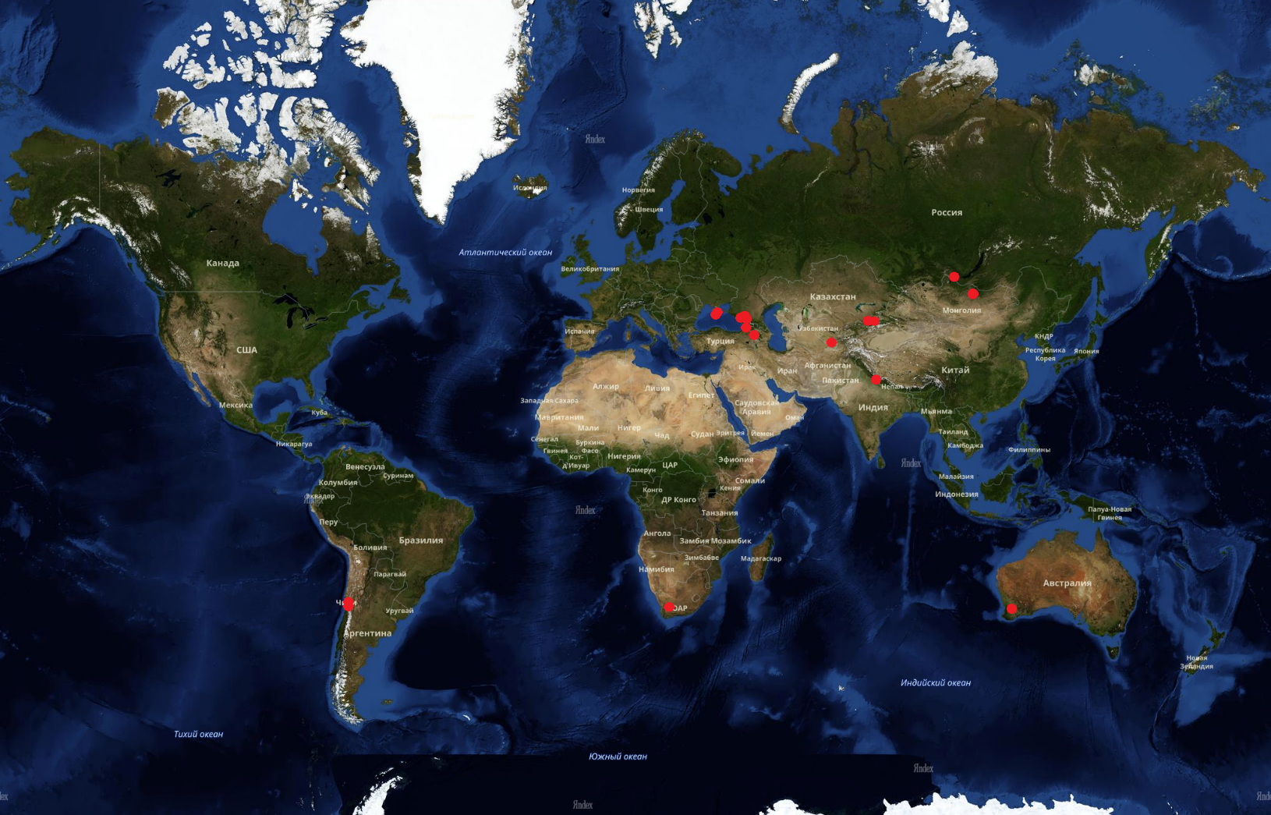
Observations
GRB-IKI FuN:
Assy-Turgen (1,5 m);
AbAO (0,8 m);
TSHAO (1 m);
CrAO (2,6 m);
Mondy (1,5 m);
SAO RAS (1 m);
Maidanak (1,5 m);
---------------------------
NUTTel (…);
GTC (10,4 m);
LBT (8,4 m);
FRAM-ORM (0,25 m).

Slide 7
Multicolor light curve of GRB 201015A
z=0,426
Afterglow
Host galaxy

Slide 8
Multicolor light curve of GRB 201015A
z=0,426
Afterglow
Host galaxy

Slide 9
Afterglow stage approximation
z=0,426
~t^{-0,96}
SN
Host galaxy

Slide 10
Supernova parameters
V-band absolute magnitude :
M_{v}= -20,01+0,75-0,44^{m}
Time from the registration of the burst to the maximum of the supernova in the observer's (source) reference frame:
t-T0= 15,75+/-2,00 (11,04+/-1,41) days.

Slide 11
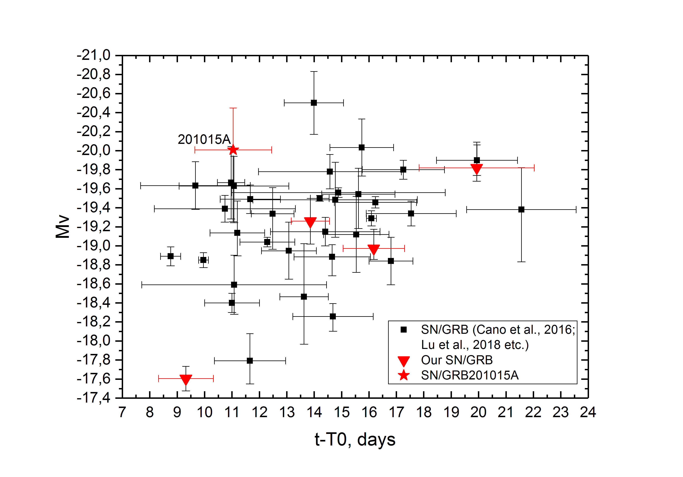
Comparison with known cases of GRB-SN

Slide 12
Spectroscopic confirmation of SN associated with GBR 201015A
Data: Rossi et al., GCN 29306;
Telescope: 2x8,4-m LBT;
Instrument: MODS;
Observation date : 2020-11-13 (UT) 04:00:00 (~28,8 day);
Exposure: 8*900 s;
Wavelength range : 3200-10000 A;
Identified SN type : Ic-BL.

Slide 13
Conclusions
An almost continuous multicolor light curve of GRB 201015A was constructed, consisting of 185 observations from X-rays to radio, which cover it from about 73 seconds after the registration of the GRB for about 3 months (85 days);
A supernova has been detected in GRB 201015A, which is another, among 24 others, cases that have received both photometric and spectroscopic confirmation of the presence of supernovae in GRBs.;
The parameters obtained are in agreement with most cases of supernovae associated with gamma-ray bursts.;
Observations of a part of the light curve in the supernova phase, along with regular observations of the afterglow stage and the host galaxy, are necessary to determine the presence or absence of a supernova in a given gamma-ray burst and to estimate its parameters;
Observations in the region of the supernova maximum at the Maidanak Astronomical Observatory made it possible to obtain photometric confirmation of its presence in this light curve.

Slide 14
Thanks for your attention!

Slide 15
Spectroscopic confirmation SN 201015A

Slide 16
Photometry of the GRB 201015A

Slide 17
SN/GRB 201015A light curve

Slide 18
Approximation of the supernova light curve by the analytical function
$$y=A∗\frac{e^{−\frac{t−t_{0}}{t_{fall}}}}{1+e^{−\frac{t−t_{0}}{t_{rise}}}}+C$$
$$y=A+Bt+Ct^{2}+Dt^{3}+Et^{4}$$
$$y=A+\frac{B}{w\sqrt{\frac{π}{2}}}e^{−2\frac{{\left(lg⁡(t)−lg(t_{0})\right)}^{2}}{w^{2}}}$$
$$y=A+Bt+Ct^{2}$$

